Slide 1
Heating and Stirring Module Design Review #5

Slide 2
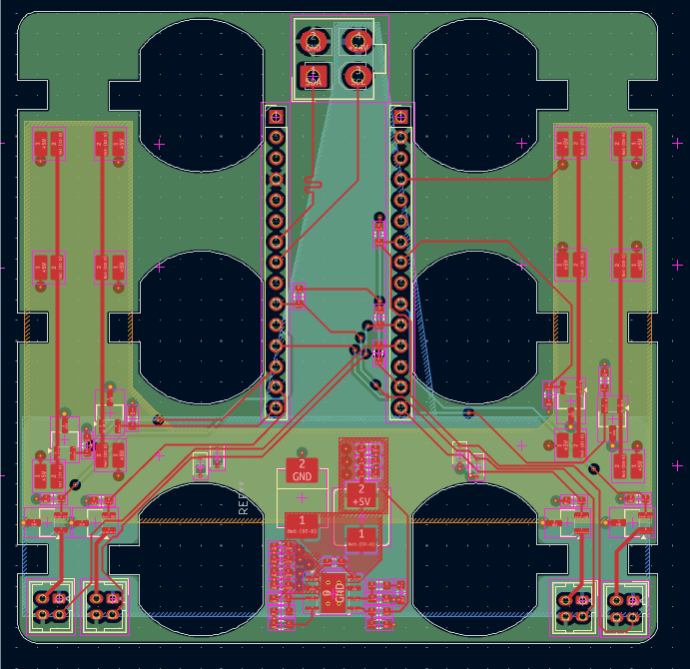
Heating & Stirring PCB
Finished routing 4-layer board
Mainly SMD components, to be assembled by hand
Designed around NUCLEO-G431KB Development board
$7 order, 5 board MOQ.

Slide 3
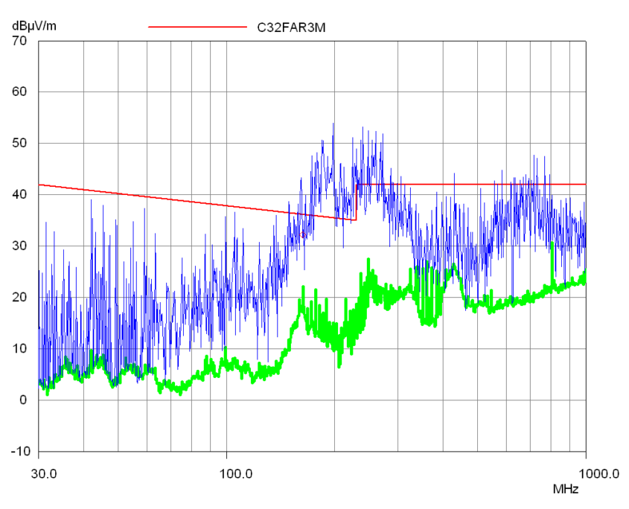
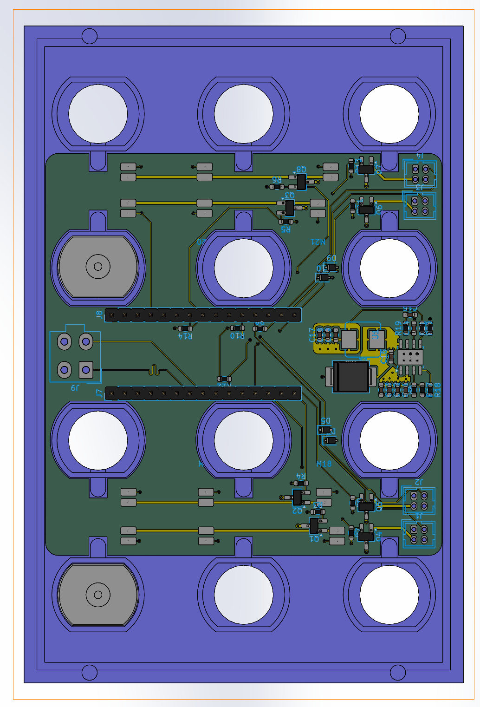
Heating & Stirring PCB
Slides directly over motor housing.
Motor housing requires alteration to account for connector placement.
Solder pads for motor connection limits repairability, lowers cost.
Ventilation?
EMI Concerns

Slide 4
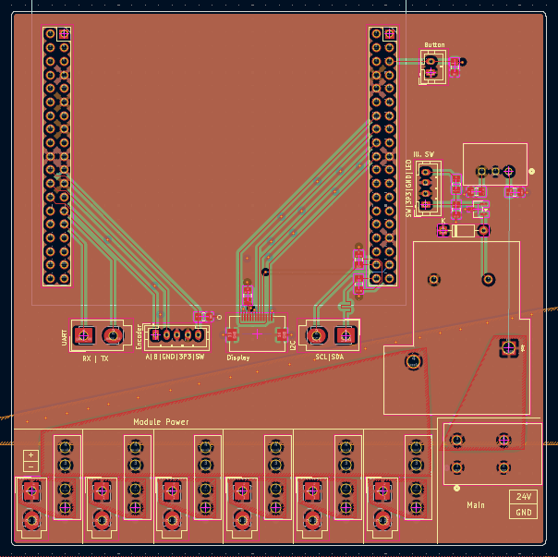
Control Hub PCB
Based on NUCLEO-C071RB development board.
~25A max draw, multi-plane power bus.
Limited power output, ~100W/module fully loaded.
Fused main and module lines, emergency stop

Slide 5
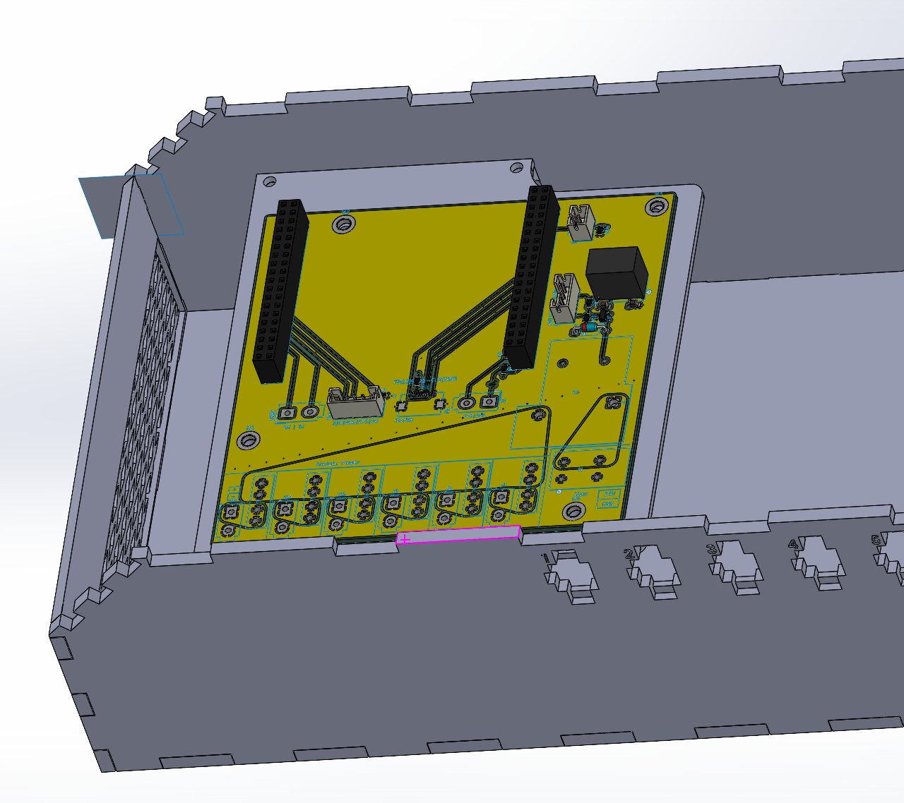
Control Hub PCB
Mounting plate, M3 screws + standoffs.
Terminal-style main connection.
MCU is over-spec, could be downsized to reduce footprint.

Slide 6
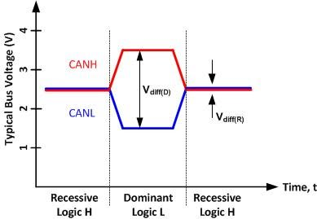
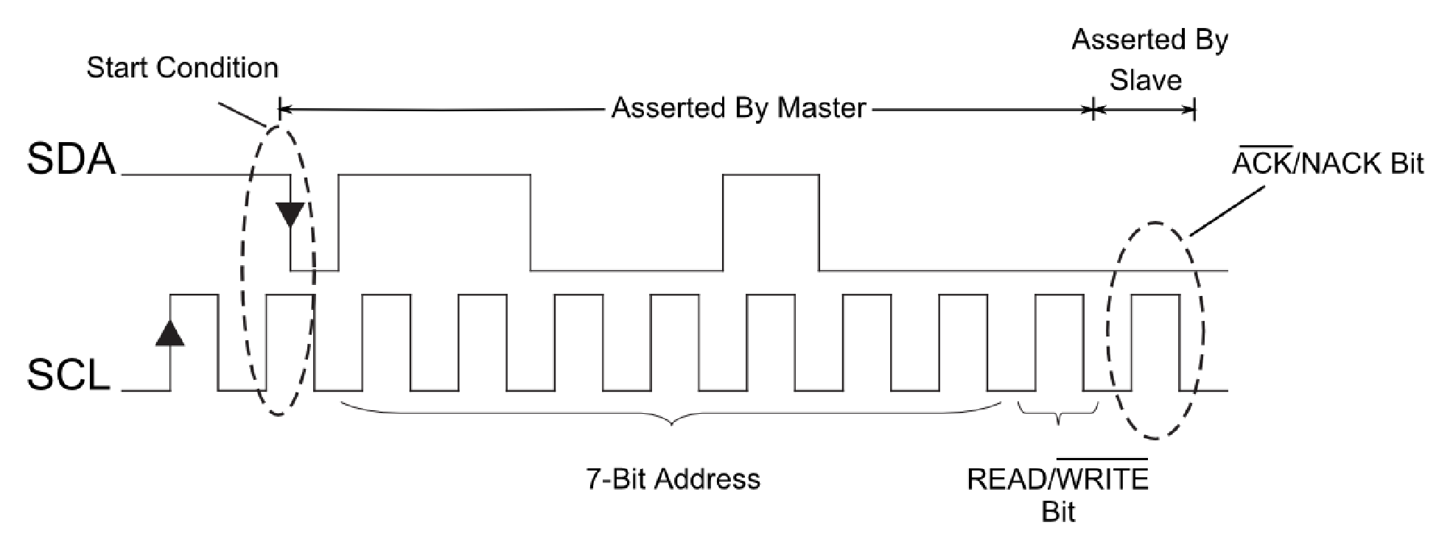
CAN-Bus vs I2C
H&S modules will be extremely noisy.
I2C is noise sensitive, resulting in packet loss.
CAN-Bus is noise resistant by nature.
Requires extra IC.
Reduces connector positions.
Modules can be “chained” together.
Slightly slower transmission speeds, negligible in our case.
CAN-BUS Timing Diagram
I2C Timing Diagram

Slide 7
Next Steps
Implement CAN-Bus.
CAN Transceivers
Hot-swappable terminating resistors
Alter housing to account for PCB changes.
Ventilation
Connector sizing
Button/Screen placement
Verify high-current design with experienced peers.

